Slide 1
University of agricultural sciences,banglore-560065 College of Agriculture, GKVK EAI-421: AI & ML in Agriculture (0+10)
PROJECT TITLE –WEATHER BASED PRICE PREDICTION MODEL
ID NO-
AMB2207
AMB2173

Slide 2
Content
Introduction
•Problem Statement
•Objectives of the project
•Dataset Overview
•Methodology/approach
•Tools and Technologies Used
•Results
•Discussion / Analysis
•Conclusion and Future Work
•References/Acknowledgements

Slide 3
INTRODUCTION
The major problem for a farmer is the price that he gets for is produce.
Agriculture commodity price is being one of the most variable thing in present modern world.if its go too low farming community gets affected if it goes to high the consumer market gets disrupted so the price should convince both farming community and consumer community.A price of a commodity is variable factor depending on Demand,Supply,Weather,Policies,Crisis,Season,War,and others.so we are creating a simulated price prediction mode; for Onion,Tomato,Chilli by correlating with weather.This is just an example of how we can creat global agriculture commodity price prediction.

Slide 4
PROBLEM STATEMENT
Unstability of price of agriculture produce
Seasonality of production
Unpredictable weather
Lack of farmer integration with Trends of supply
Project Goal
Develop machine learning model to predict agriculture commodity prices and trends based on weather and season

Slide 5
OBJECTIVES
To create a ML model to predict future prices of agriculture produce
creating awareness about future prices of farmer produce
creating sesonal trends of specific produce that helps farmers what to grow in what season
Assured price prediction helps in storaging of produce in warehose
In country price stabilization by grid prediction system

Slide 6
DATASET OVERVIEW
Averagw indian weather data of past 10 years was collected on daily basis(Rainfall,Humidity,Temperature)
average indian prices of commodity (Onion,Tomato,Chilli)of past 10 years on daily basis.
Data source(for weather)
NOAA
NASA POWER
OPEN WEATHER
METEOSTAT
Data source( for commodity price)
AGMARKNET
FAOSTAT DATASET
WORLD BANK COMMODITY PRICES

Slide 7
India - Daily Weather & Vegetable Price Data (Apr 2016 - Apr 2026)
Date Info |  |  |  | Weather Data (India Avg) |  |  | Vegetable Prices (Rs/kg)
Date | Day | Month | Year | Temp (C) | Rainfall (mm) | Humidity (%) | Onion (Rs/kg) | Tomato (Rs/kg) | Chilli (Rs/kg)
16-Apr-2016 | Saturday | April | 2016 | 30.9 | 0.2 | 52.6 | 41.5 | 38.9 | 128.3
17-Apr-2016 | Sunday | April | 2016 | 29.7 | 0.7 | 32.6 | 42.4 | 37.5 | 126.8
18-Apr-2016 | Monday | April | 2016 | 29.6 | 0.5 | 51.7 | 40.3 | 36.1 | 125.5
19-Apr-2016 | Tuesday | April | 2016 | 31.1 | 0.2 | 35.9 | 40.1 | 42.5 | 126.8
20-Apr-2016 | Wednesday | April | 2016 | 30.9 | 0.7 | 46.6 | 39.3 | 41.7 | 123.7
21-Apr-2016 | Thursday | April | 2016 | 31.6 | 2.5 | 47.1 | 37.9 | 48.7 | 127.4
22-Apr-2016 | Friday | April | 2016 | 30.6 | 0.4 | 42.7 | 37.7 | 47.9 | 129.7
23-Apr-2016 | Saturday | April | 2016 | 33.0 | 0.1 | 46.0 | 35.6 | 49.3 | 132.4
24-Apr-2016 | Sunday | April | 2016 | 33.4 | 0.1 | 31.1 | 34.7 | 48.4 | 127.9
25-Apr-2016 | Monday | April | 2016 | 30.4 | 1.2 | 39.4 | 33.2 | 50.5 | 128.9
26-Apr-2016 | Tuesday | April | 2016 | 30.8 | 0.6 | 40.7 | 33.7 | 54.2 | 139.0
27-Apr-2016 | Wednesday | April | 2016 | 31.5 | 1.4 | 28.0 | 33.4 | 56.4 | 139.1
28-Apr-2016 | Thursday | April | 2016 | 34.2 | 2.1 | 35.8 | 32.4 | 55.0 | 140.6
29-Apr-2016 | Friday | April | 2016 | 32.2 | 0.1 | 45.4 | 33.1 | 58.3 | 141.1
30-Apr-2016 | Saturday | April | 2016 | 33.3 | 0.3 | 37.3 | 32.7 | 54.5 | 133.2

Slide 8
Problems in the Dataset and Model
weather cannot be only factor for price prediction
the trend may be only for general it may not applied for every situation
emergency situation may occure that can influence the price
the demand and supply may change according to consumer and produce
The data collection cannot be average based on country ,states,this may give in accurate prediction
Data collection should be made on only on grid base system which is very difficult

Slide 9
APPROACH
•
• Data Preprocessing
Upload CSV/Excel dataset in Google Colab
Feature selected(Rainfall,Temperature,Humidity)
Normalize data
Train-test split (80:20)
• Exploratory Data Analysis
Correlation heatmap
Identify key influencing parameters

Slide 10
• Model Selection
Random Forest
Decision Tree
Logistic Regression
• Model Training & Validation
Train models on training data
Test on unseen data
• Evaluation Metrics
Accuracy
Confusion Matrix

Slide 11
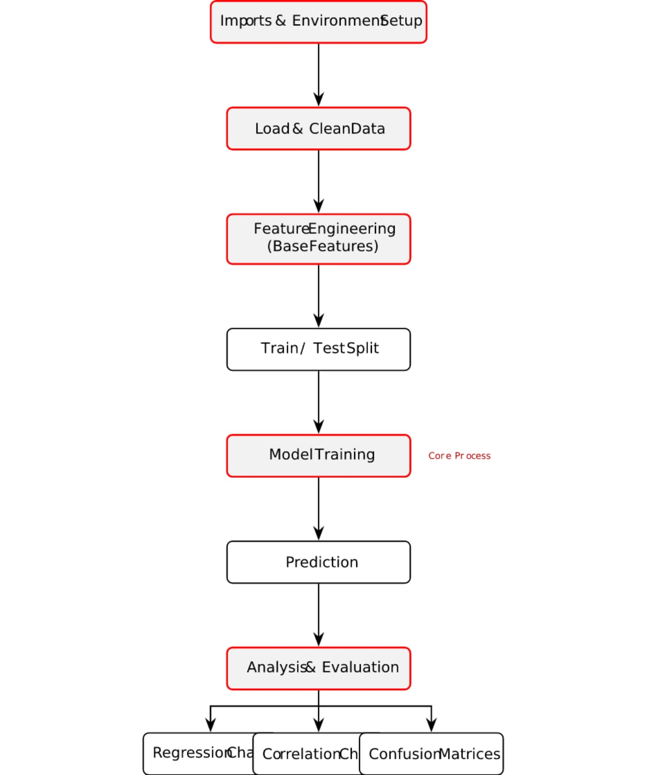

Slide 12
Tool / Technology | Role in the Project
Python 3.x | Core programming language used to implement the entire ML pipeline
pandas | Used for data loading, manipulation, and preprocessing of dataset
NumPy | Performs numerical computations and array operations
matplotlib | Used for data visualization like bar charts and heatmaps
scikit-learn | Machine learning library used for model building and evaluation
Random Forest Classifier | Ensemble algorithm that improves accuracy using multiple decision trees
Decision Tree Classifier | Tree-based model that classifies data using decision rules
Logistic Regression | Statistical model used for binary classification (Safe/Unsafe)
train_test_split | Splits dataset into training and testing sets
Confusion Matrix | Evaluates classification performance by comparing actual vs predicted values

Slide 13
OUTPUT
TRAINING RANDOM FOREST MODELS (80% train / 20% test)
=================================================================
[Onion]
Train: 2945 | Test: 737
Regressor - MAE: Rs3.86/kg | RMSE: Rs4.86/kg | R2: 0.9041
Classifier - Accuracy: 81.14%
precision recall f1-score support
Low 0.85 0.87 0.86 233
Medium 0.73 0.74 0.74 262
High 0.86 0.83 0.85 242
accuracy 0.81 737
macro avg 0.81 0.81 0.81 737
weighted avg 0.81 0.81 0.81 737
[Tomato]
Train: 2945 | Test: 737
Regressor - MAE: Rs5.16/kg | RMSE: Rs7.07/kg | R2: 0.8829
Classifier - Accuracy: 83.18%
precision recall f1-score support
Low 0.85 0.87 0.86 256
Medium 0.73 0.74 0.74 235
High 0.91 0.88 0.89 246
accuracy 0.83 737
macro avg 0.83 0.83 0.83 737
weighted avg 0.83 0.83 0.83 737

Slide 14
[Chilli]
Train: 2945 | Test: 737
Regressor - MAE: Rs9.23/kg | RMSE: Rs11.58/kg | R2: 0.8565
Classifier - Accuracy: 79.78%
precision recall f1-score support
Low 0.86 0.86 0.86 243
Medium 0.68 0.69 0.69 235
High 0.85 0.84 0.84 259
accuracy 0.80 737
macro avg 0.80 0.80 0.80 737
weighted avg 0.80 0.80 0.80 737
FINAL MODEL EVALUATION SUMMARY
=================================================================
Vegetable Train Test MAE (Rs) RMSE (Rs) R2 Cls Acc
-----------------------------------------------------------------
Onion 2945 737 3.86 4.86 0.9041 81.14%
Tomato 2945 737 5.16 7.07 0.8829 83.18%
Chilli 2945 737 9.23 11.58 0.8565 79.78%

Slide 15
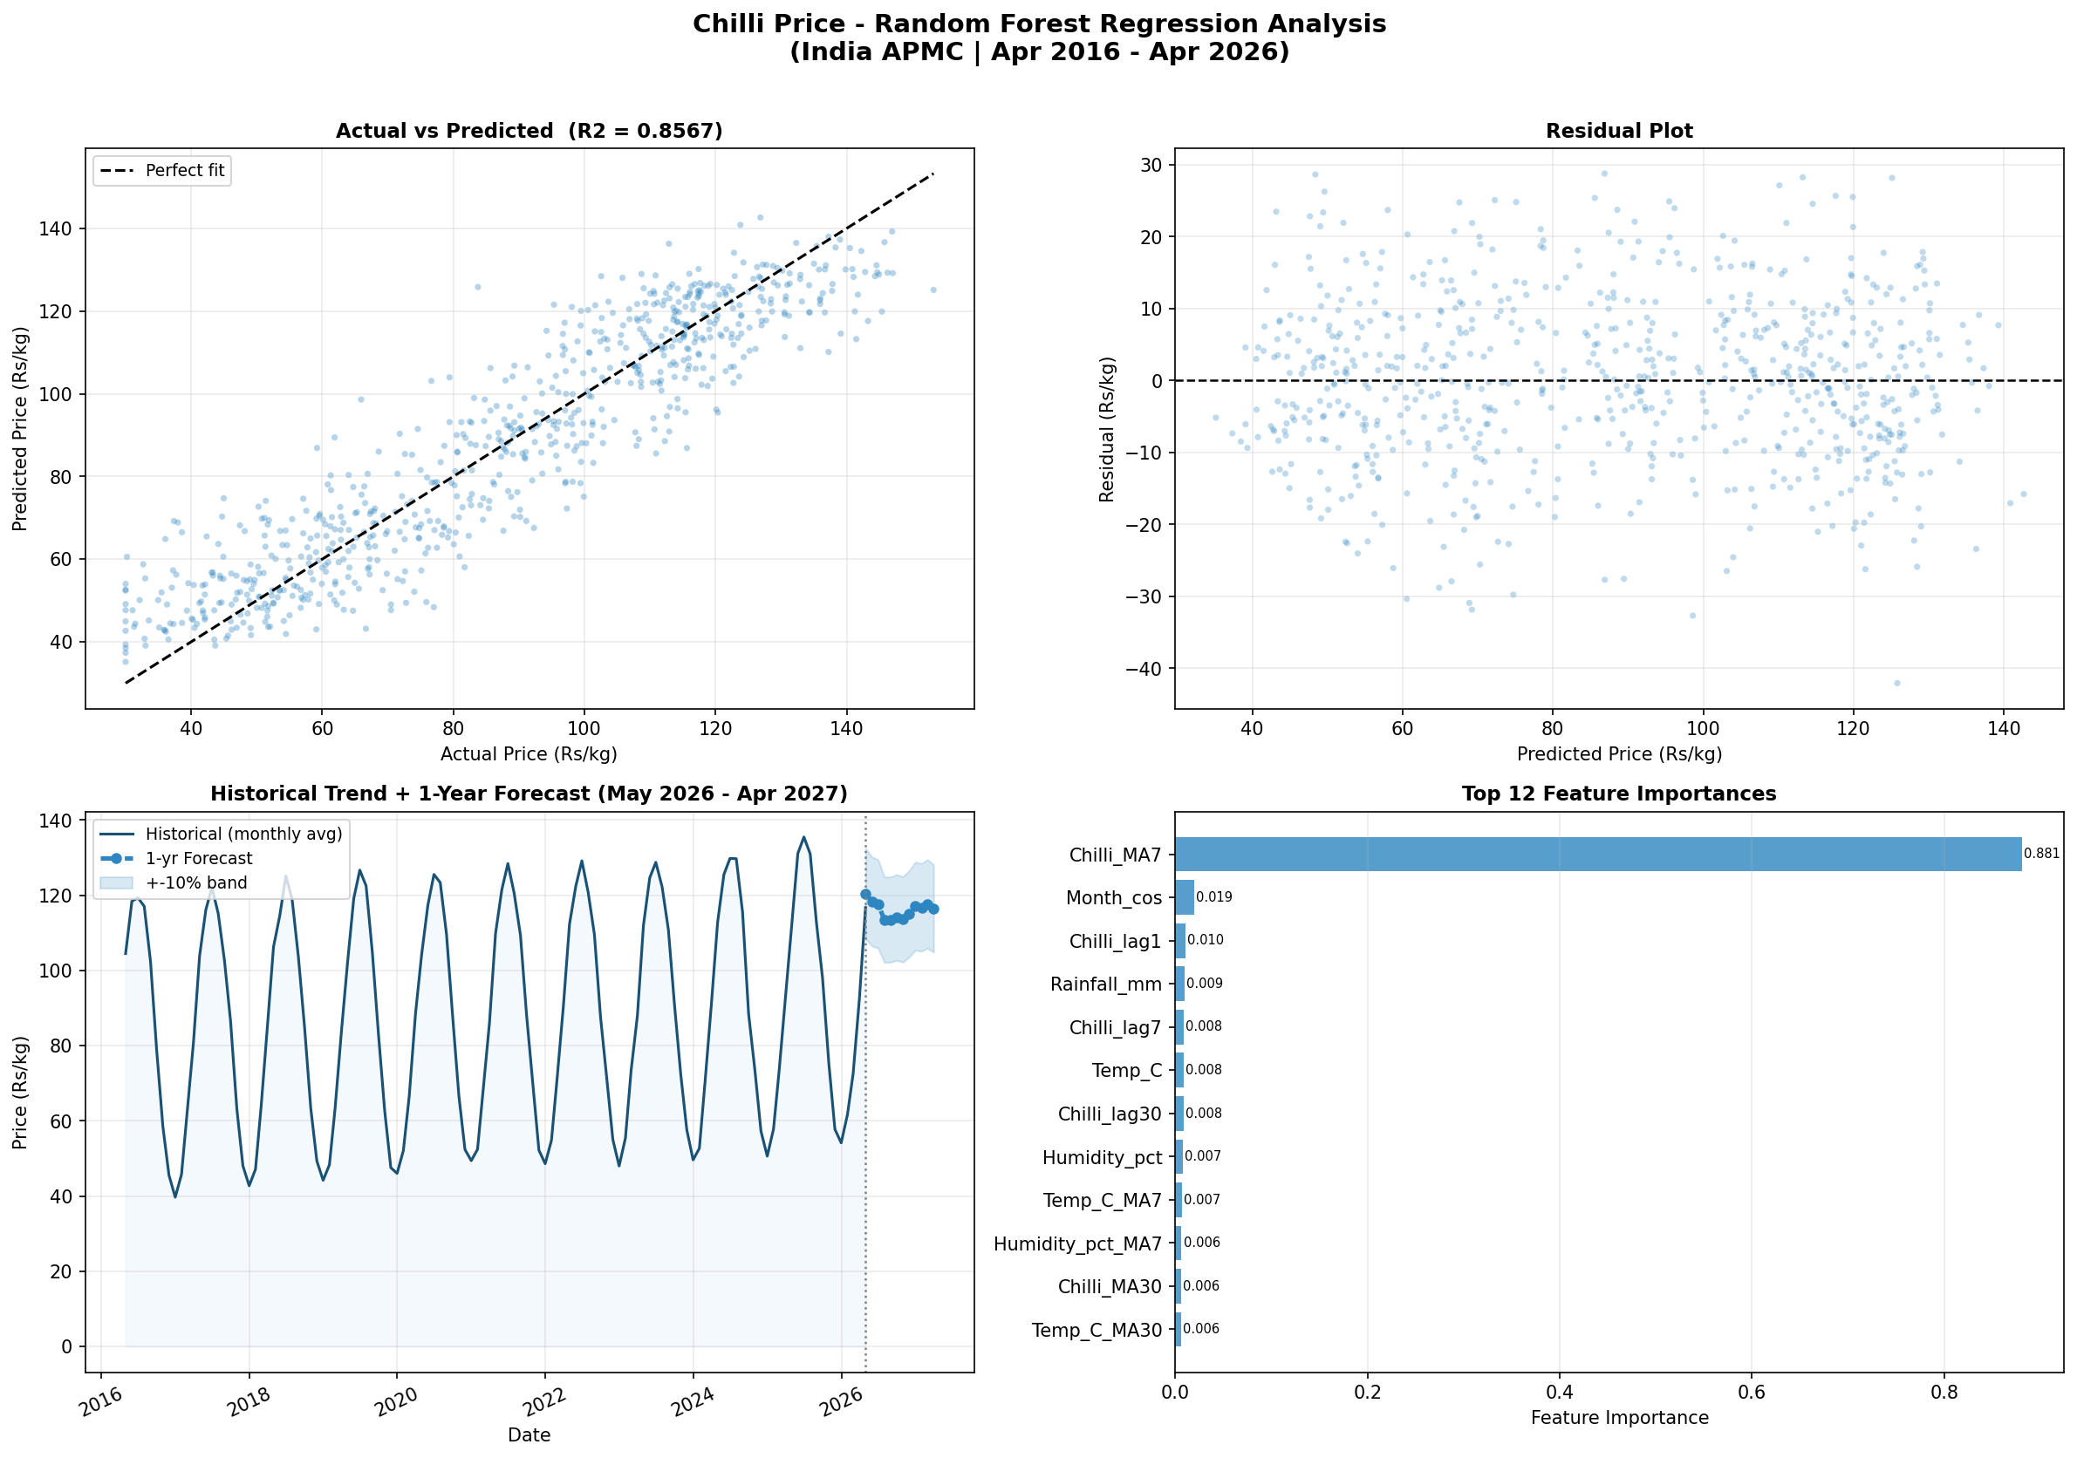

Slide 16
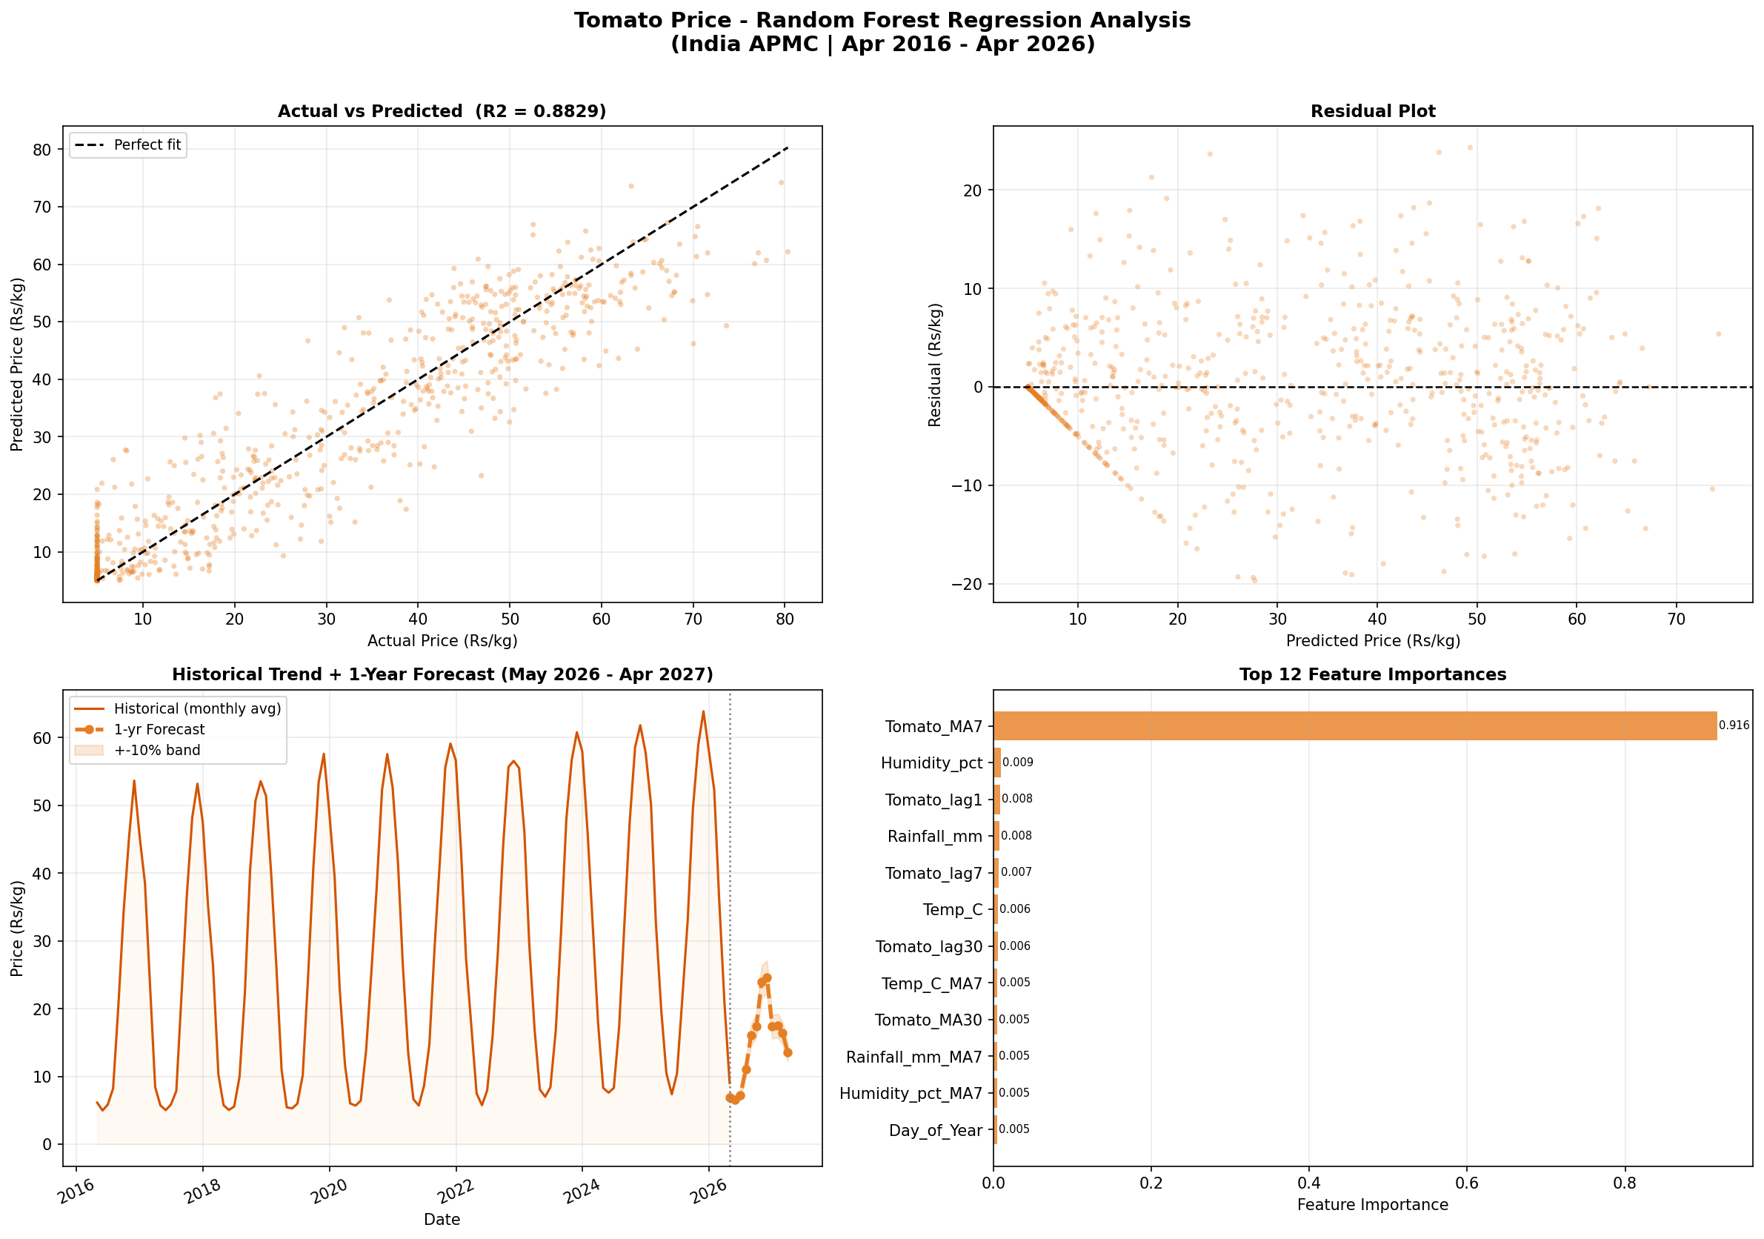

Slide 17
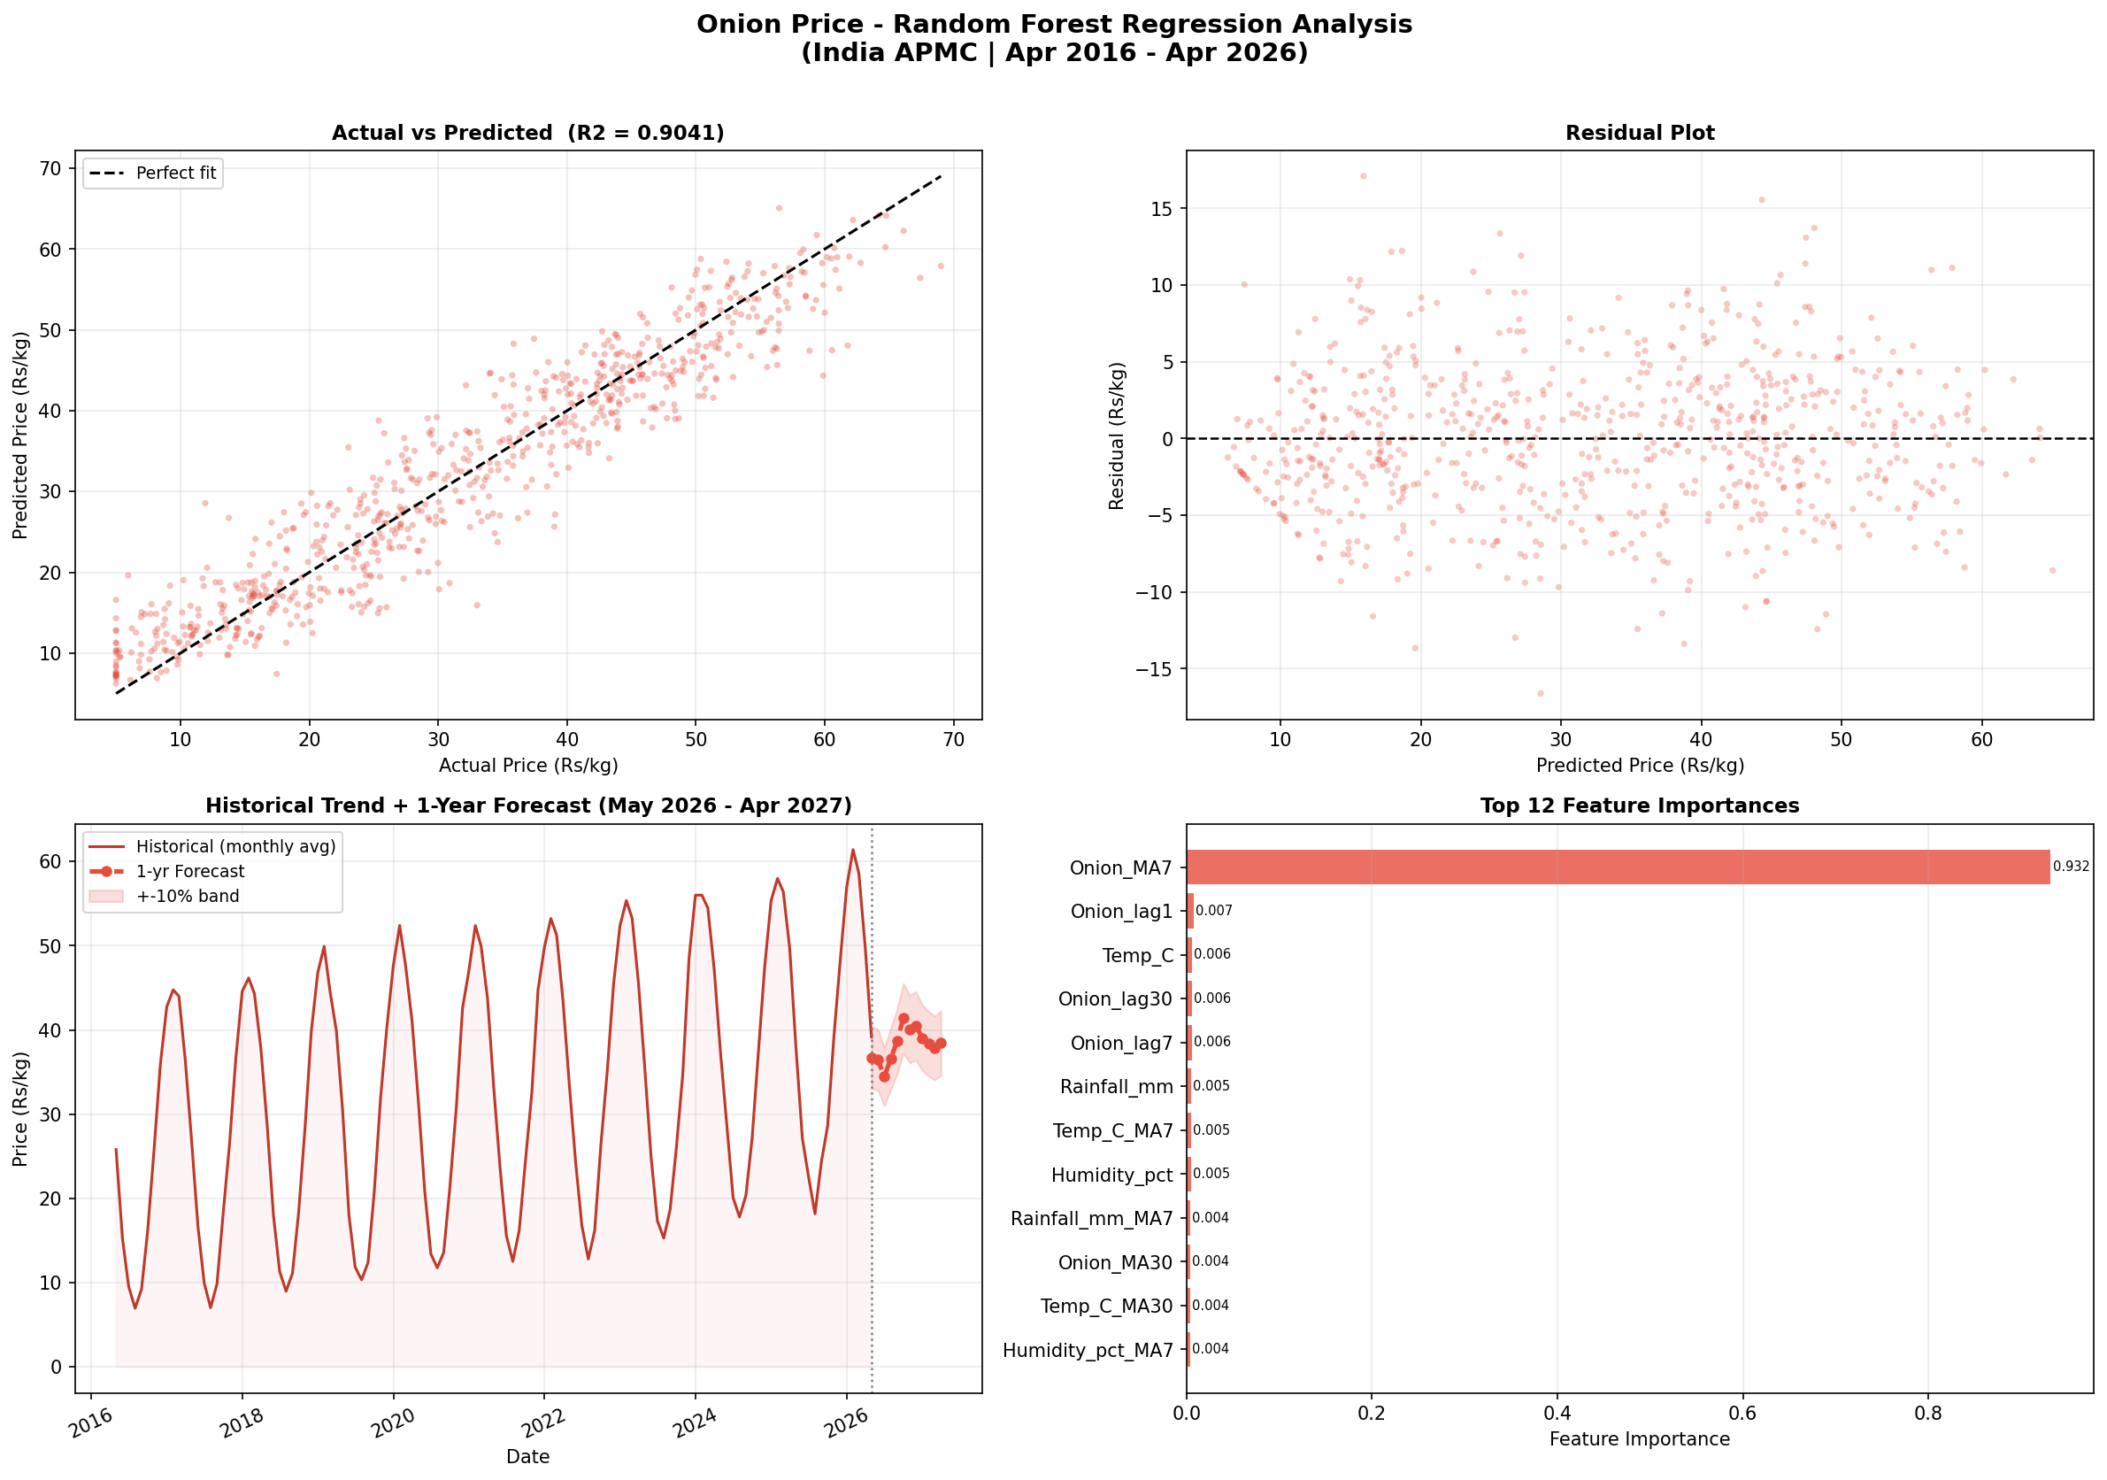

Slide 18
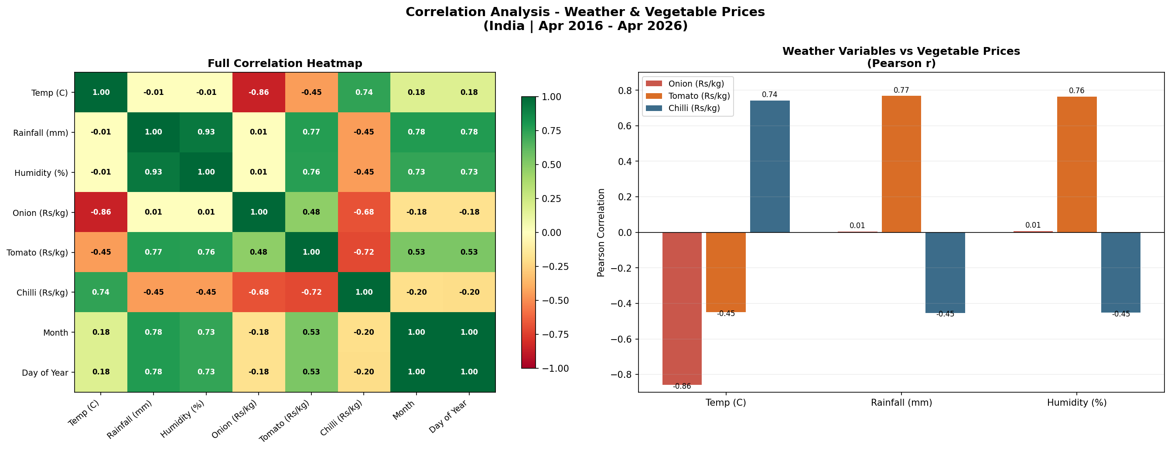

Slide 19
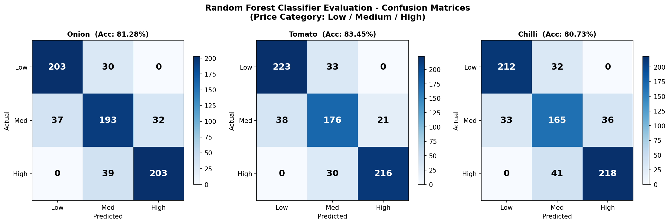

Slide 20
FINAL OUTPUT
1-YEAR PRICE FORECAST (May 2026 - Apr 2027)
=================================================================
Month Onion (Rs) Tomato (Rs) Chilli (Rs) Temp(C) Rain(mm)
----------------------------------------------------------------------
May 2026 36.76 6.94 120.12 32.2 7.9
Jun 2026 36.43 6.56 118.33 34.8 6.9
Jul 2026 34.46 7.25 117.31 36.0 48.0
Aug 2026 36.55 11.09 113.44 35.1 87.8
Sep 2026 38.67 16.14 113.86 32.2 117.1
Oct 2026 41.38 17.45 113.99 28.0 127.6
Nov 2026 40.10 23.97 113.12 23.9 116.3
Dec 2026 40.62 24.68 115.17 21.1 87.4
Jan 2027 39.01 17.36 117.38 20.3 48.4
Feb 2027 38.28 17.52 116.65 21.1 7.7
Mar 2027 37.81 16.43 117.82 24.0 8.1
Apr 2027 38.44 13.57 116.33 28.1 8.4

Slide 21
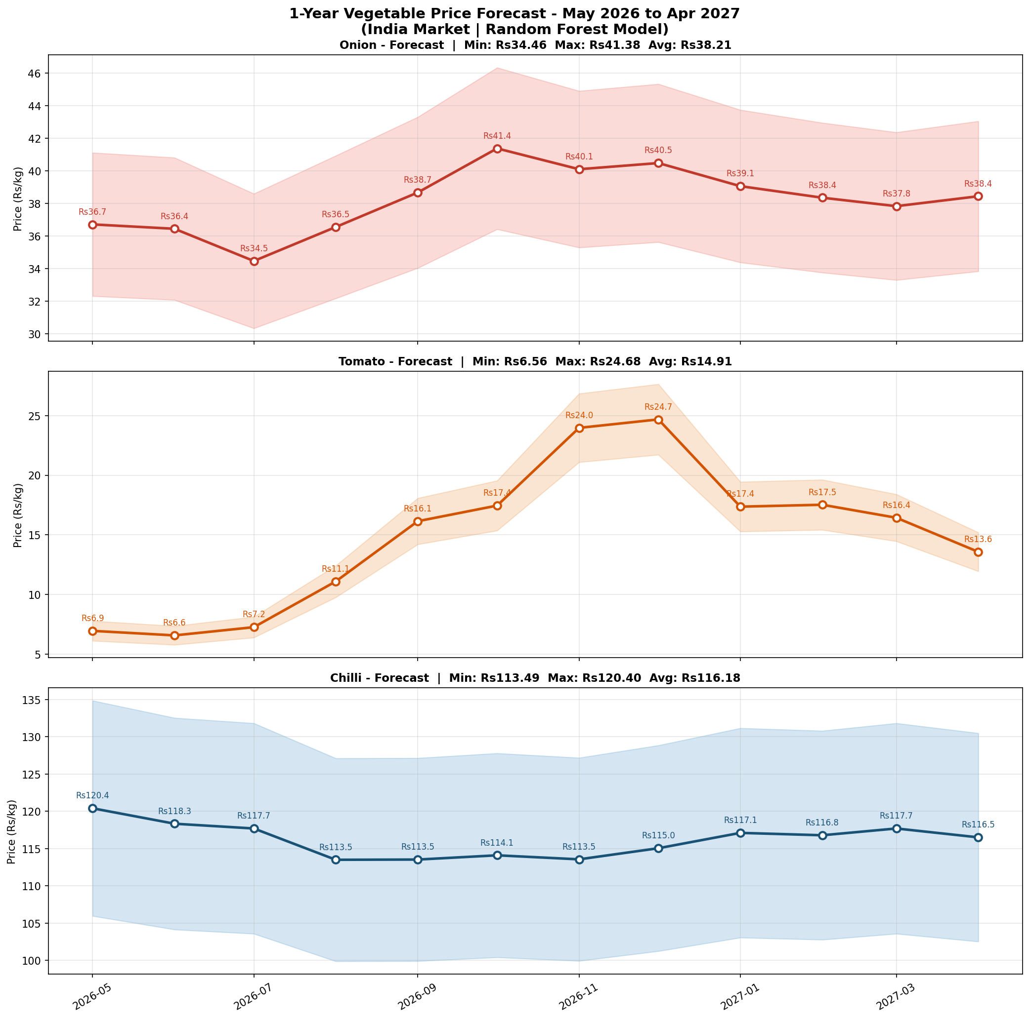

Slide 22
DISCUSSION
1.Challenges Faced (Data Quality, Noise, Imbalance, Feature Selection)
1.Presence of missing values and noisy data affected model performance.
2.Class imbalance (more “safe” than “unsafe” samples) required careful handling for accurate prediction.

Slide 23
Limitations of the Approach or Dataset
1.Limited dataset size and region-specific data reduce generalization to other areas.
2.Lack of temporal data (seasonal variations) limits long-term prediction capability.
Impact on Agricultural Decision-Making
1.Helps farmers identify possible prices of agricultural commodities so they can choose the proper crop to grow.
2.helps to stabilize the prices in country /state

Slide 24
FUTUREWORK
uploading broad data set to train the model(grid based)
Dividing the predictions based on grids,state,country.
Making the model self learning by giving access to real time data
Feeding model with production details,possible diseases for accuracy of prediction
Predictions which is also integrated with real time war,Crisis,Demand,Supply.
By using the prediction letting know the possible exports abd imports
Stabilization of in country variable prices by using Grid based predictions

Slide 25
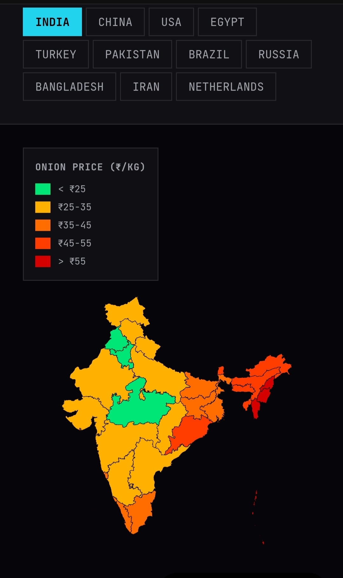
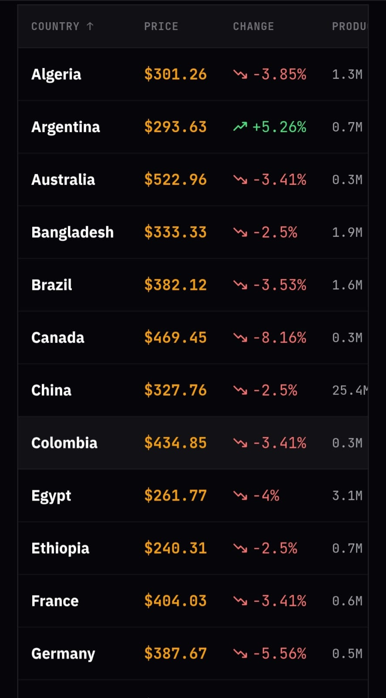
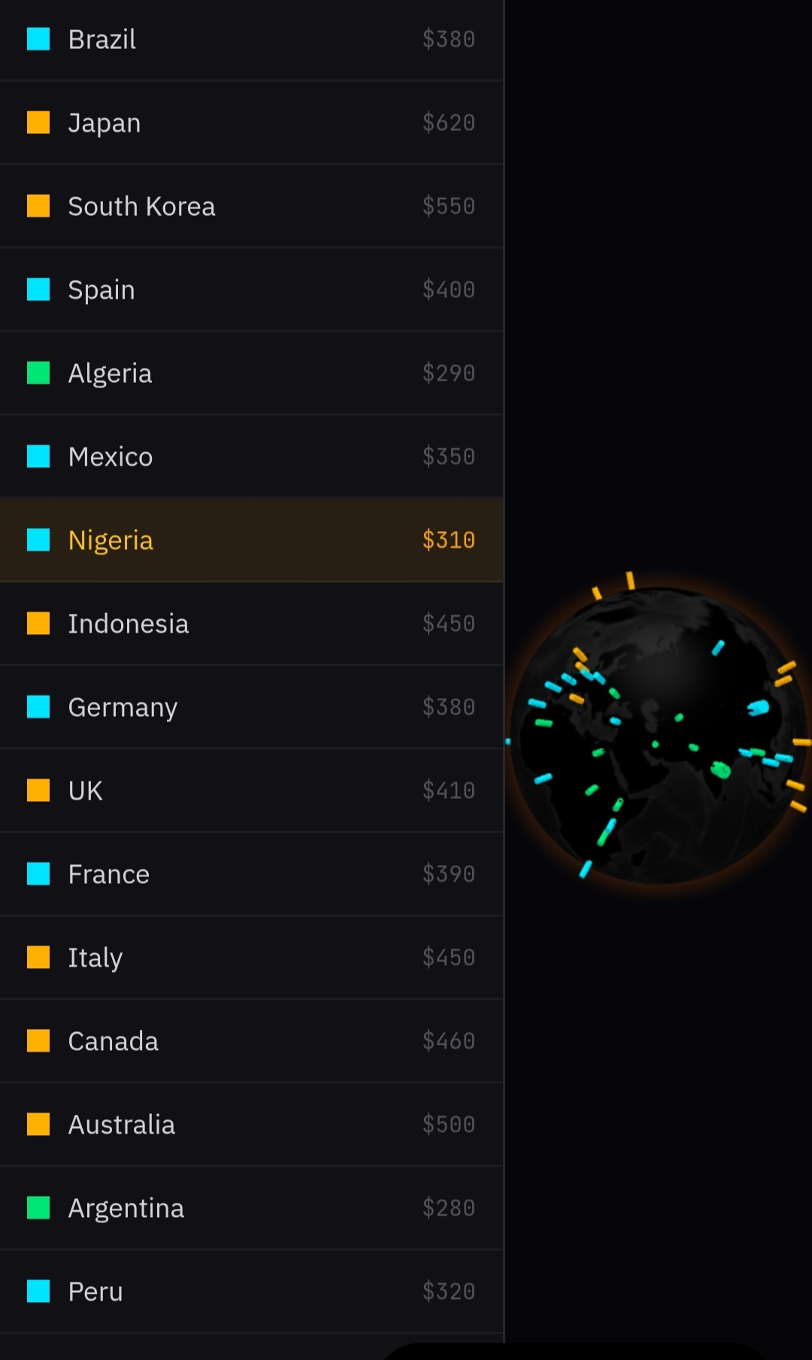

Slide 26
══════════ THANK YOU ! ══════════

